Slide 1


Capstone Project Mid-term Review
REGIME DETECTION FOR FINANCIAL MARKETS
Sponsor: Mr. Blaz Zlicar (Deutsche Bank)
Advisor: Prof. Sasha Stoikov (Cornell Financial Engineering Manhattan)
Team: Enming Zhang, Haobing Meng, Huimin Wang, Joel Dsouza, Niharika Dalsania, Yiran Hao, Yuanping Du

Slide 2




Background
Data
Agenda
Methodology and Result
Next Steps

Slide 3

What are Market Regimes?
Initial thought - Bull versus Bear Markets
Any clusters of fairly persistent market conditions
Bull
Bear
Static
High Volatility
Crisis
Inflation
and so on…
Deutsche Bank
Cornell Financial Engineering Manhattan

Slide 4
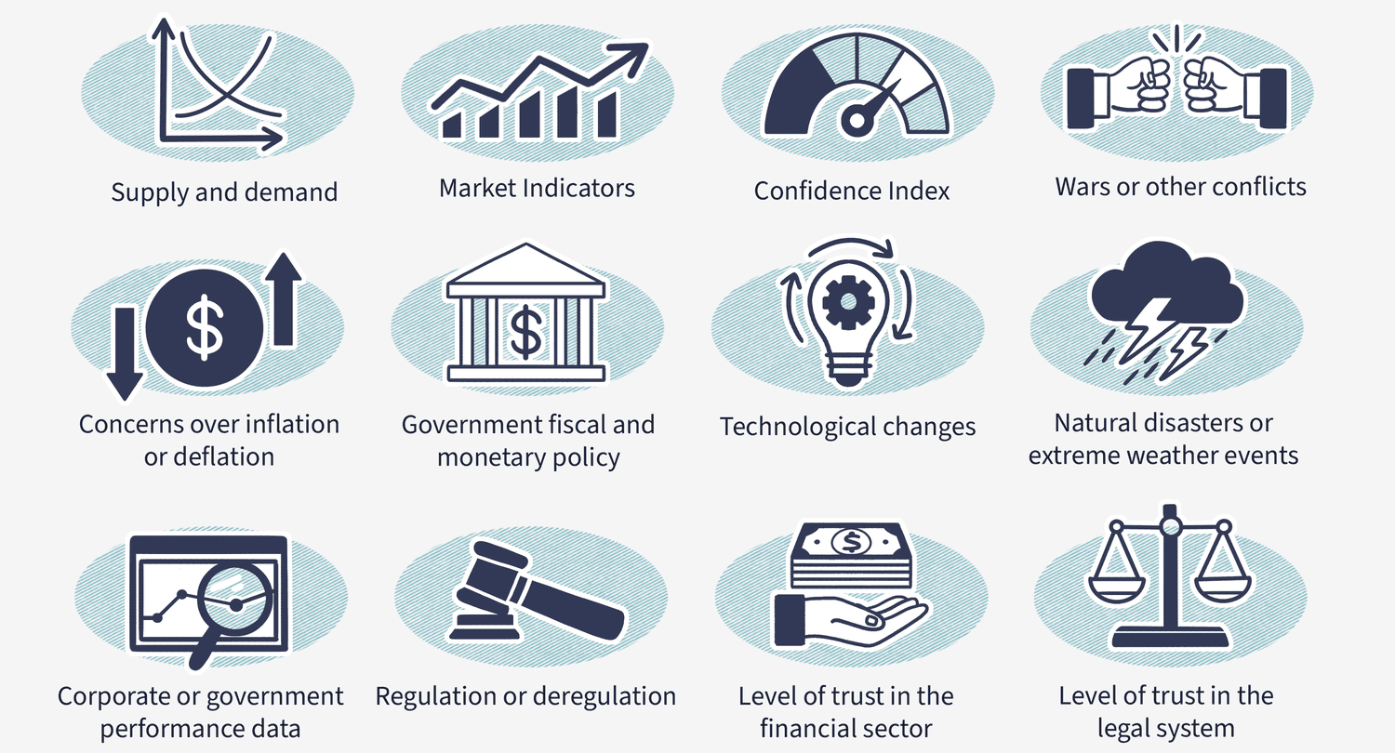
Why do Market Regimes exist?
Russia-Ukraine
War
Rates hike by Fed
Deutsche Bank
Cornell Financial Engineering Manhattan

Slide 5

Why is Market Regime Detection Important?
Why do we care? – important for portfolio asset allocation; not all assets do well in all market conditions
Good thing about regime clusters? – identifiable in a scientifically robust manner
Added advantages? – portfolio returns boosted by macroeconomics-driven investment decision and tail risk management
Deutsche Bank
Cornell Financial Engineering Manhattan

Slide 6
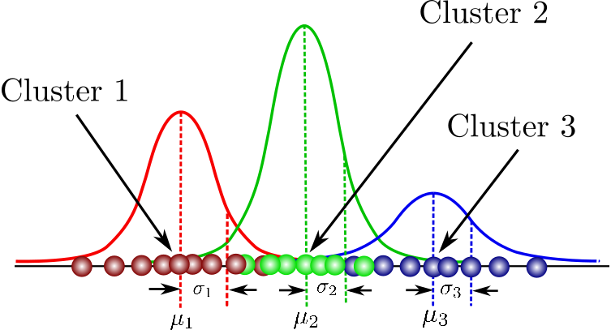
Previous Works
Various approaches:
Supervised Models: require labor intensive labeling of “true labels” for training data regimes
Unsupervised Models: challenging to map the identified cluster to real-world regimes
Two Sigma's approach - Use unsupervised GMM for regime detection
Our approach - Follow Two Sigma’s approach to detect regimes out of samples and to build trading strategies on
Deutsche Bank
Cornell Financial Engineering Manhattan

Slide 7
Background
Data
Agenda
Methodology and Result
Next Steps

Slide 8
Factor Data
Core Macro | Secondary Macro | Macro Styles | Equity Styles
Interest Rate | Foreign Currency | Fixed Income Carry | Low Risk
Equity | Emerging Market | Foreign Exchange Carry | Momentum
Credit | Equity Long Short | Trend Following | Quality
Commodity | Local Inflation |  | Value
Holistic
Parsimonious
Orthogonal
Actionable
*Refer Appendix 2.1 for details
Deutsche Bank
Cornell Financial Engineering Manhattan

Slide 9
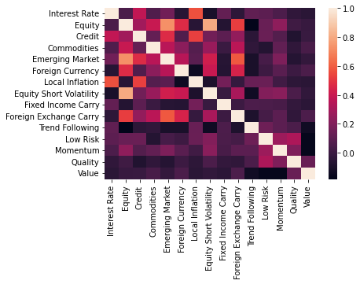
Data Processing and Analysis
Source
Bloomberg and DB Proprietary Indices
Frequency and Duration:
Daily data from Jan 2002 to Aug 2022
Preprocessing
Forward Fill Missing data
Log return of price series
Correlation Analysis*
All factors relatively uncorrelated
*Refer Appendix 2.2 for details
Deutsche Bank
Cornell Financial Engineering Manhattan

Slide 10
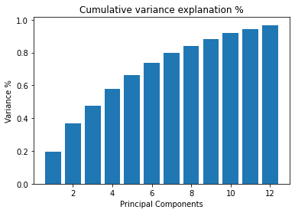
Principal Component Analysis (PCA)
The first 12 principal components explain about 95% of the variance
Factors are informative and uncorrelated; there is no need to eliminate any factors
Deutsche Bank
Cornell Financial Engineering Manhattan

Slide 11
Background
Data
Agenda
Methodology and Result
Next Steps

Slide 12
Flow Chart
Mean and variances of smooth regimes
Train data
Train the GMM
Detected regimes
Smooth regimes in train data
Portfolio Construction and Analysis
Trained
parameters
Optimal Markowitz
weights in each regime
Test data
Detect regimes using trained GMM
Detected regimes
Smooth regimes in test data
Performance Evaluation
Deutsche Bank
Cornell Financial Engineering Manhattan

Slide 13
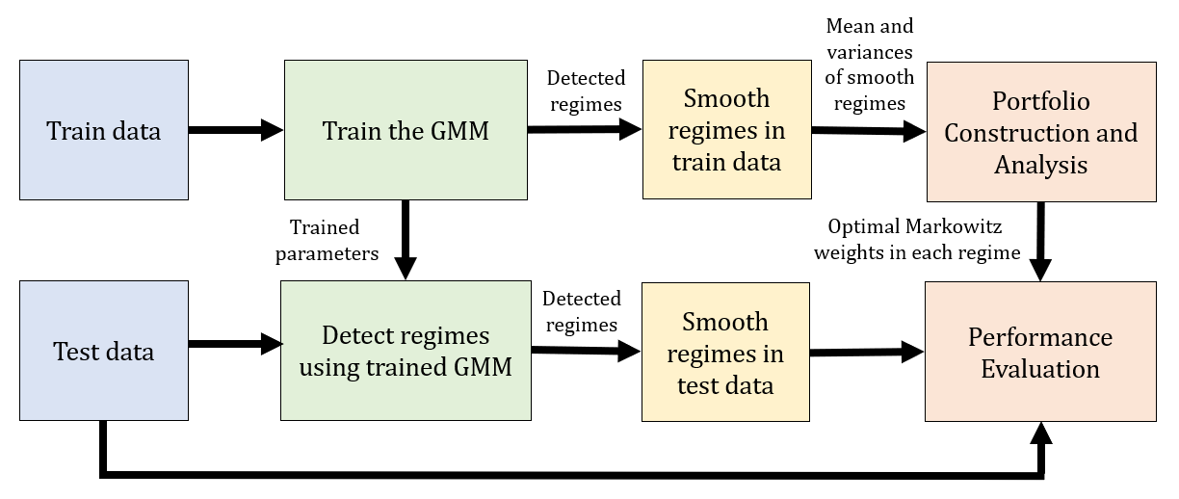

Flow Chart
Train data
15 factor data
Numbers of regimes
Random initialisations
Number of iterations
Train the GMM
Hyperparameter Tuning
Model
Sensitivity Analysis
$$\left[\begin{matrix}\begin{aligned}μ_{1} \\ μ_{2}\end{aligned} & \begin{aligned}Σ_{1} \\ Σ_{2}\end{aligned} \\ μ_{3} & Σ_{3} \\ μ_{4} & Σ_{4}\end{matrix}\right]$$
Probabilities of being in a certain regime (p1, p2, p3, p4)
Detected regime has probability
max(p1, p2, p3, p4)
Deutsche Bank
Cornell Financial Engineering Manhattan

Slide 14

Flow Chart
Smooth regimes in train data
Probability Threshold
Probability Exponential
Weighted Average
Regime Maximum
Count
Portfolio Construction and Analysis
Markowitz Portfolios
Long-only portfolios
Weights for portfolio in each regime (understand if it makes intuitive sense in real world)
$$\left[\begin{matrix}\begin{aligned}μ_{1} \\ μ_{2}\end{aligned} & \begin{aligned}Σ_{1} \\ Σ_{2}\end{aligned} \\ μ_{3} & Σ_{3} \\ μ_{4} & Σ_{4}\end{matrix}\right]$$
on smooth regimes
Use these parameters to map detected regimes to real world regimes
Deutsche Bank
Cornell Financial Engineering Manhattan

Slide 15
Flow Chart
Test data
15 factor data
Detect regimes using trained GMM
Trained model
Probabilities of being in a certain regime (p1, p2, p3, p4)
Detected regime has probability
max(p1, p2, p3, p4)
Deutsche Bank
Cornell Financial Engineering Manhattan

Slide 16
Flow Chart
Smooth regimes in test data
Regime Maximum
Count
Performance Evaluation
Out-of-sample performance
PNL
Sharpe Ratio
Maximum Drawdown
Calmar Ratio
Final smooth regimes for weekly rebalanced portfolio
Deutsche Bank
Cornell Financial Engineering Manhattan

Slide 17
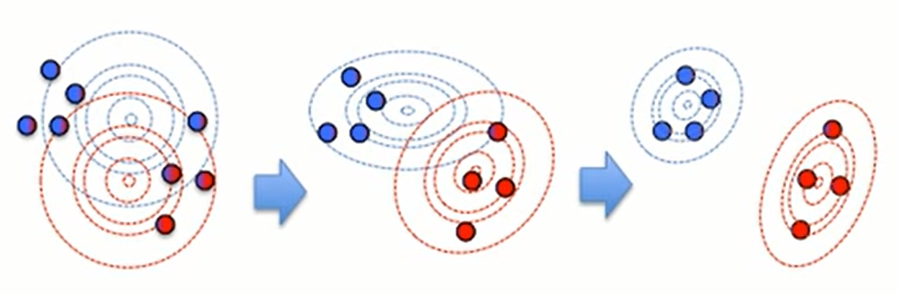
Gaussian Mixture Model (GMM)
Assumption - data is a mixture of K Gaussian components
Unsupervised model parameterized by two things
Component means and variances/covariances
Estimates of component probabilities given the data
Estimate parameters using Expectation-Maximisation
Initialize the parameters
Keep looping until the convergence of the parameters:
Expectation - calculate the expectation of the component assignments for each data point given the model parameters
Maximization - maximize the expectations calculated above with respect to the model parameters and update the values of parameters
Deutsche Bank
Cornell Financial Engineering Manhattan
Notes:
A Gaussian mixture model is a probabilistic model that assumes all the data points are generated from a mixture of a finite number of Gaussian distributions with unknown parameters. We can think of it as generalizing k-means clustering to incorporate information about the centers as well as the covariance structure of the data and latent Gaussians.
The number of the Gaussian components, K, is a hyper parameter that needs to be given to the model.
Once K is given, GMM can automatically calculate:
The distribution of each gaussian component: mean and covariance
The probability that each observation belongs to each gaussian component, cluster
EM algo
Initialize the params (mean and cov for each gaussian component)
E-step: Given current param, calculate the prob that j-th observation comes from k-th component, times the probability density of the k-th component at the observation; sum over all observations and all components M-step: Calculate the updated params

Slide 18
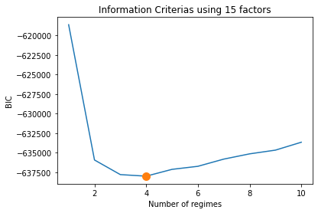
Hyperparameter Tuning
Tune for optimal number of regimes
Chose optimal as the one with least BIC score
Optimal number of regimes is 4
we can use portfolio performance as metric when designing portfolios
Deutsche Bank
Cornell Financial Engineering Manhattan
Notes:
As we mentioned before, the number of the Gaussian components, regime, K, is a hyper parameter that needs to be given to the model.
In order to conduct model selection, we use BIC to determine the optimal regime number. BIC score gives an estimate of the model performance, lower BIC score signals a better model. As we can see from the plot, 4 regimes generate the lowest BIC thus is the optimal number of regime.
Later on, when we design trading strategies based on regime switching model, we can use portfolio performance (sharpe) as a metric.
BIC is given by the formula: BIC = -2 * loglikelihood + d * log(N). where N is the sample size of the training set and d is the total number of parameters.

Slide 19
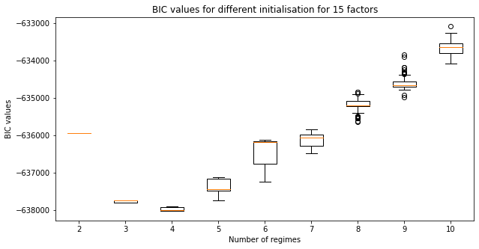
Sensitivity Analysis
Run model with 100 different random initializations
4 is the optimal number of regime irrespective of initialization
Deutsche Bank
Cornell Financial Engineering Manhattan
Notes:
Furthermore, we conduct sensitivity analysis for the hyperparameter choice based on different initialization of the model, which is the first step of the EM algo.
The initialization include the mean and covariance matrix for each Gaussian components.
What we did is that, for each given K, we run the model with 100 different random initializations, record BIC each time, and draw the box plot. Here’s the box plots for different Ks.
As we can see, 4 is still the optimal number of regime irrespective of initialization.

Slide 20
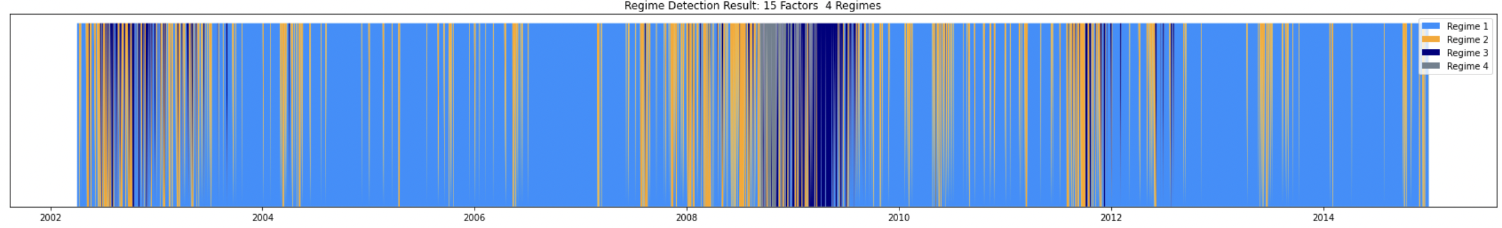
Initial Results
GMM output: 4 probabilities of being in either of the 4 regimes
GMM picks the regimes with the highest probability
Issue: Regimes switch frequently - high transaction costs for frequent rebalancing
Solution: Smoothing regimes should yield more robust and stable results
Deutsche Bank
Cornell Financial Engineering Manhattan

Slide 21
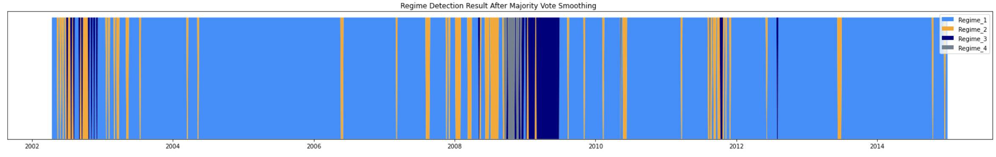
Regime Smoothing
Probability Threshold - identify regime only when maximum probability regime exceeds threshold
Issue - threshold is an added parameter
Probability Average - choose regime with maximum exponential weighted average probability
Issue - smoothing factor alpha for exponential weighted average is an added parameter
Rolling Window Majority – chose regime as the majority regime in past 5 days (1 trading week)
No issues
All performs same - choose Rolling Window Majority to avoid extra parameters (complex model)
Deutsche Bank
Cornell Financial Engineering Manhattan
Notes:
TODO! – Explain all smoothing methods
TODO! – explain why choose max count (prob threshold – threshold is extra param, exp weighted avg. smoothing factor alpha is extra param – adds complexity, avoid that by simple max count over past 5 days to stick to weekly rebalancing which is practical too)
TODO! Plot smooth regimes on same time frame as before and highlight same region to show difference

Slide 22
Regime Smoothing
Original regimes (top) versus Rolling Window Majority smooth regimes (bottom)
Deutsche Bank
Cornell Financial Engineering Manhattan
Notes:
TODO! – Explain all smoothing methods
TODO! – explain why choose max count (prob threshold – threshold is extra param, exp weighted avg. smoothing factor alpha is extra param – adds complexity, avoid that by simple max count over past 5 days to stick to weekly rebalancing which is practical too)
TODO! Plot smooth regimes on same time frame as before and highlight same region to show difference

Slide 23
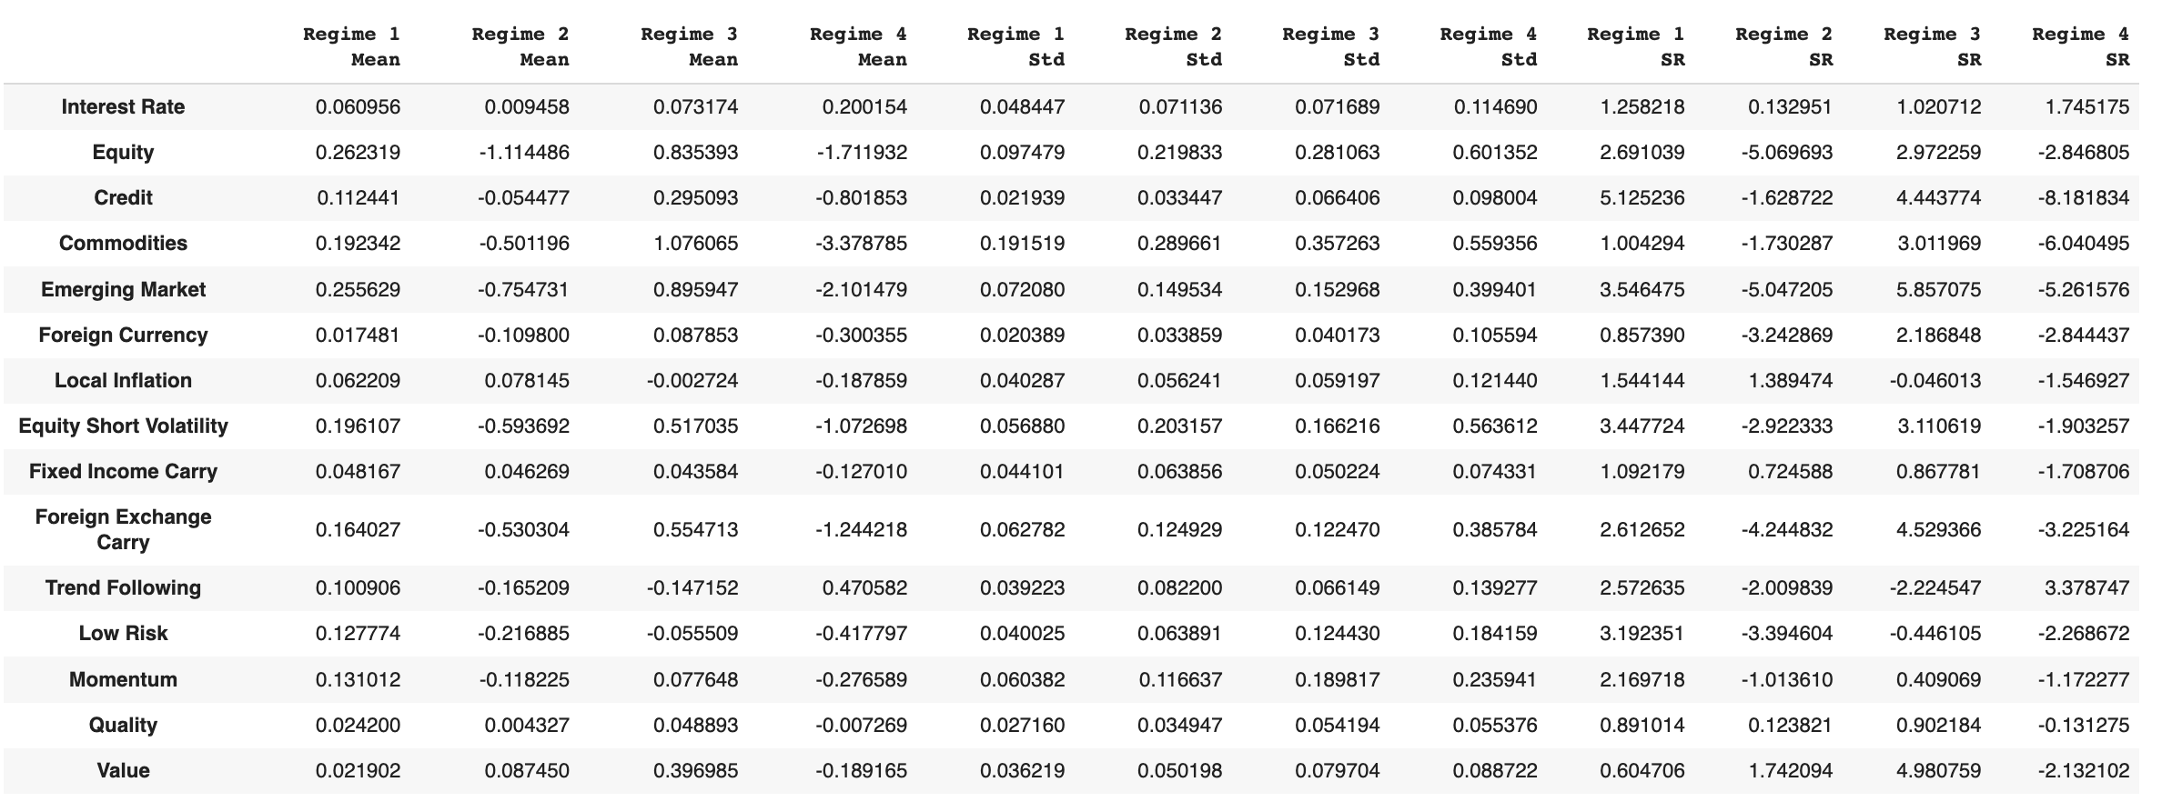
Regime Interpretation
Regime 1 | Regime 2 | Regime 3 | Regime 4
Steady State | High Inflation | Walking on Ice | Crisis
Almost all positive returns | Most factors are negative, except FI, inflation and value | High returns | Almost all negative returns
Low volatility for almost all | High volatility in commodity | High volatility | High volatility for almost all
Calculation Based on Training set from 2002 to 2014
Deutsche Bank
Cornell Financial Engineering Manhattan
Notes:
TODO! - Look at mean and variance in all regimes after smoothing and map to real world regimes, Highlight means and variance that help make the decision.

Slide 24
Markowitz Portfolios
Markowitz allocates weights to different factors at different regimes
Certain factors have zero weights in certain regime; we could modify optimizing cost function to increase diversifications and to allocate a minimal weight
 | Interest Rate | Equity | Credit | Commo-dities | Emerging Market | Foreign Currency | Local Inflation | Equity Short Vol. | Fixed Income Carry | Foreign Exchange Carry | Trend Follow | Low Risk | Momentum | Quality | Value
Steady state | 0 | 0 | 0.4862 | 0.0041 | 0.0173 | 0 | 0 | 0.1217 | 0.0506 | 0.0387 | 0.0363 | 0.0597 | 0.0506 | 0.0580 | 0.0763
High Inflation | 0 | 0 | 0 | 0 | 0 | 0 | 0.3768 | 0 | 0.0910 | 0 | 0 | 0 | 0 | 0 | 0.5321
Walking on Ice | 0 | 0 | 0.1628 | 0 | 0.1321 | 0 | 0 | 0.0372 | 0.3205 | 0.0540 | 0.0425 | 0.0588 | 0 | 0.0945 | 0.0973
Crisis | 0.4328 | 0 | 0 | 0 | 0 | 0 | 0 | 0 | 0 | 0 | 0.5671 | 0 | 0 | 0 | 0
Weights on train set of 2002-2014
Deutsche Bank
Cornell Financial Engineering Manhattan
Notes:
In

Slide 25
Long-only Portfolios
Long-only portfolios only focus on the best factors to long
Choose highest Sharpe ratio factors in different regimes
 | Steady State | High Inflation | Walking on Ice | Crisis
Highest Sharpe Ratio | Credit | Value | Emerging Market | Trend Following
Second Highest Sharpe Ratio | Emerging Market | Local Inflation | Value | Interest Rate
Portfolios on train set of 2002-2014
Deutsche Bank
Cornell Financial Engineering Manhattan

Slide 26
Performance Testing
Rolling window testing
Detect regimes on test data using trained parameters
Smooth the test regimes by enforcing weekly rebalancing
Use regime-wise portfolios built earlier to calculate PNL of different strategies
2002｜2003｜ ··· ｜2013｜2014｜2015｜2016｜
Test Dataset
Training Dataset
2002｜2003｜ ··· ｜2013｜2014｜2015｜2016｜
Training Dataset
Test Dataset
Deutsche Bank
Cornell Financial Engineering Manhattan

Slide 27
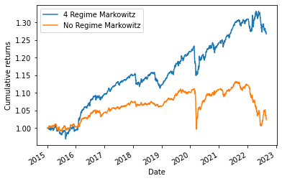
Result Summary: Markowitz Portfolios
Model | Annualized Return | Sharpe Ratio | Max Drawdown | Calmar Ratio
3 Regime | 0.004732 | 0.155483 | 0.108133 | 0.049032
4 Regime | 0.032221 | 1.021803 | 0.067633 | 0.476273
5 Regime | 0.013950 | 0.462056 | 0.078559 | 0.182483
No regime | 0.003186 | 0.134913 | 0.111323 | 0.031645
Deutsche Bank
Cornell Financial Engineering Manhattan

Slide 28
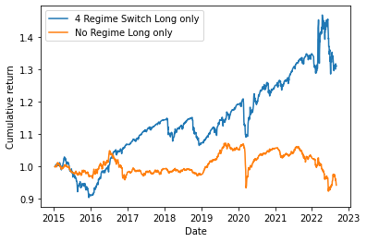
Result Summary: Long-only Portfolios
Model | Annualized Return | Sharpe Ratio | Max Drawdown | Calmar Ratio
3 Regime | 0.015706 | 0.324483 | 0.120656 | 0.136886
4 Regime | 0.038395 | 0.606952 | 0.124493 | 0.318405
5 Regime | 0.033298 | 0.479512 | 0.214135 | 0.163788
No regime | -0.008206 | -0.194489 | 0.139635 | -0.063436
Deutsche Bank
Cornell Financial Engineering Manhattan

Slide 29
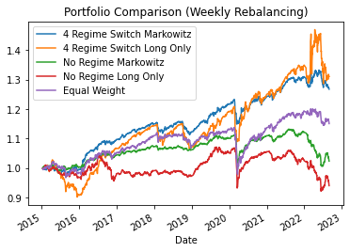
Result Summary
Model | Annualized Return | Sharpe Ratio | Max Drawdown | Calmar Ratio
4 Regime Long only | 0.038395 | 0.606952 | 0.124493 | 0.318405
4 Regime Markowitz | 0.032221 | 1.021803 | 0.067633 | 0.476273
Equal Weight | 0.019000 | 0.460638 | 0.139632 | 0.141408
Deutsche Bank
Cornell Financial Engineering Manhattan

Slide 30
Background
Data
Agenda
Methodology and Result
Next Steps

Slide 31



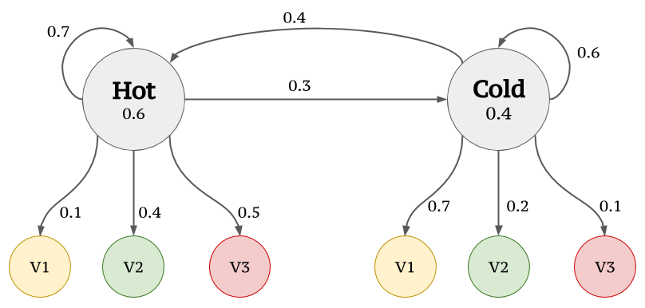
Next Steps
Dynamic number of regimes for each test year
Trading different strategies and factors
Adding other metrics for determining regimes
Trying HMM and comparing with GMM performance
Deutsche Bank
Cornell Financial Engineering Manhattan

Slide 32
QUESTIONS?

Slide 33
APPENDIX

Slide 34
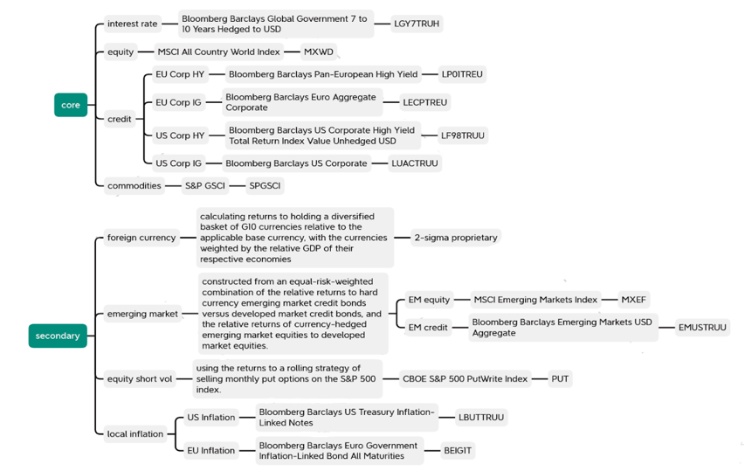
Appendix 2.1
Deutsche Bank
Cornell Financial Engineering Manhattan

Slide 35
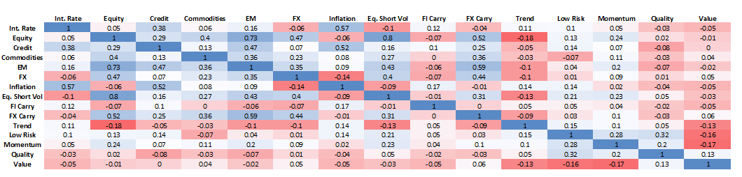
Appendix 2.2
Noticeable positive correlations (No noticeable negative correlations)
80% - Equity and Equity Short Volatility
73% Equity and Emerging Market
59% Emerging Markets and Foreign Exchange Carry
57% - Interest Rate and Inflation
Deutsche Bank
Cornell Financial Engineering Manhattan

